Slide 1
Availability of GAST D versus
Ground Broadcast EIG Parameters and Airborne Geometry Screening
Matt Harris, Paul Schlais

Slide 2
Simulation Assumptions

Slide 3
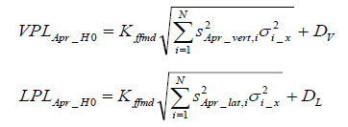
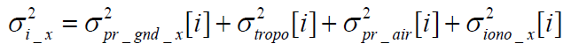
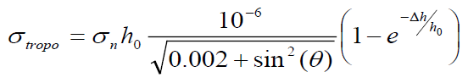
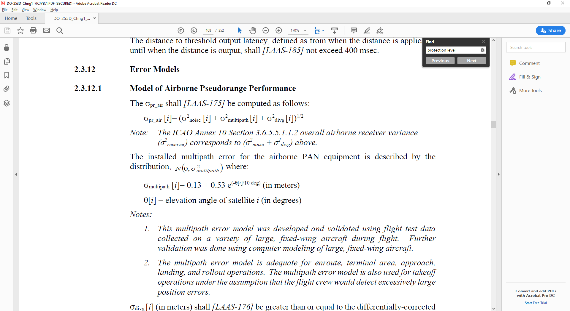
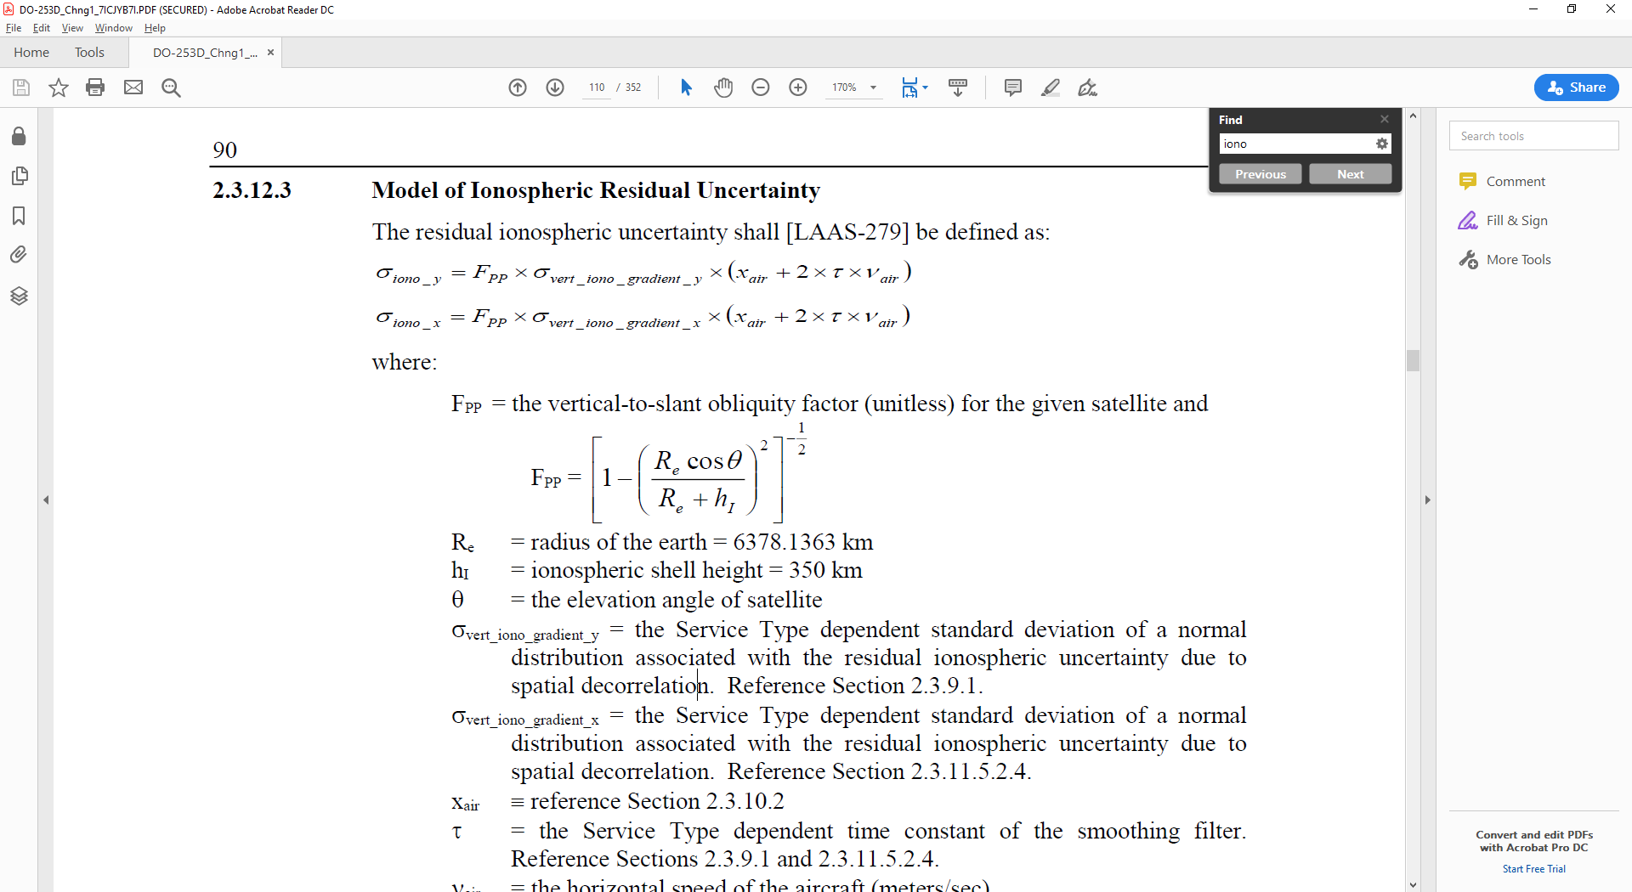



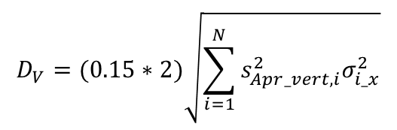

Availability Simulation Assumptions (1/4)
VPL, LPL Equations
  σD_{V}, σD_{L} assumed to be 15% of σ_{vert}, and σ_{lat} in the position domain, used 2-σ value for DV, DL in availability
    Reference: Murphy, Harris, Beauchamp, “Implications of 30-Second Smoothing for GBAS Approach Service Type D”, ION ITM 2010
  GAST = D, M = 4, K_{ffmd} = 5.847, h₀ = 14300 m, σ_{n} = 25, Δh = 15.24 m, σ_{vert_iono_gradient_x} = 4 mm/km, τ = 30s, v_{air} = 81 m/s,
  x_{air} dependent on E_{IG}, see next slide
$$D_{V}=(0.15∗2)\sqrt{\sum_{i=1}^{N}{s_{Apr_vert,i}^{2}σ_{i_x}^{2}}}$$
$$D_{L}=(0.15∗2)\sqrt{\sum_{i=1}^{N}{s_{Apr_lat,i}^{2}σ_{i_x}^{2}}}$$
σ_{pr_gnd}$=\sqrt{\frac{{0.24}^{2}}{M}+{0.04}^{2}}$ for $θ$ < 35
$$σ\text{pr}\text{_}\text{air}\text{ = }\text{.11 }\text{+}\text{ .14}×\text{e} \text{(−}θ\text{/}\text{4}\text{)}$$
(AAD B)
(GAD C)
σ_{pr_gnd}$=\sqrt{{\frac{(0.15+0.84×\text{e} \text{(−}θ\text{/15.5)})}{M}}^{2}+{0.04}^{2}}$ for $θ$ ≥ 35,

Slide 4


Availability Simulation Assumptions (2/4)
User Distance from GBAS (x_{air})
  Dependent on assumed E_{IG}, linear:
  Assume Y_{EIG} = 0.2 m, M_{EIG} = 0.5 m/km (500 mm/km)
$$E_{IG}=M_{EIG}x_{air}+Y_{EIG}$$
$$x_{air}=\frac{E_{IG}−Y_{EIG}}{M_{EIG}}$$
E_{IG} | 2.5 m | 2.75 m | 3.0 m | 3.25 m | 3.5 m
X_{air} | 4.6 km | 5.1 km | 5.6 km | 6.1 km | 6.6 km

Slide 5
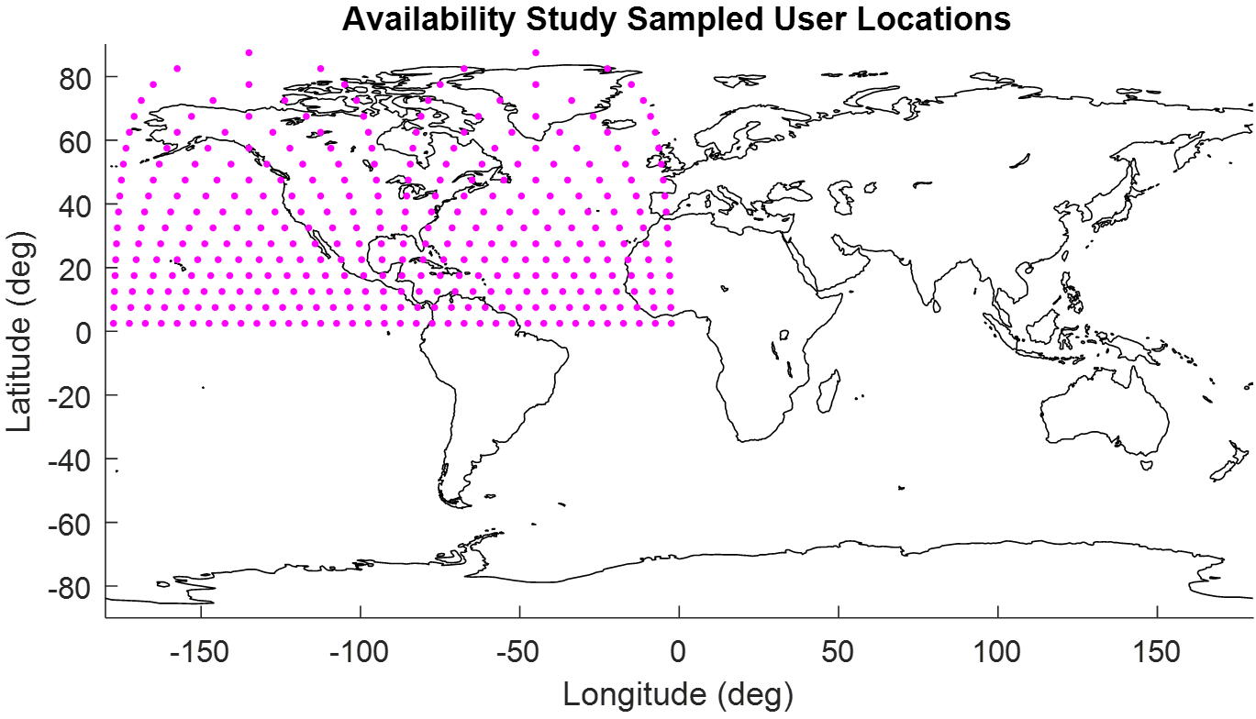
Availability Simulation Assumptions (3/4)
User Locations
  Grid-like pattern for half hemisphere (1/4 globe)
    Approx. equidistant spacing
    Contains all the unique data necessary to apply to full globe
  Half hemisphere results applied to rest of globe
    Side study on a simple full-world run confirmed only half hemisphere is necessary
    Mirrored over equator
    Translated 90° longitude
  One minute time steps
    sidereal day (1436 minutes)

Slide 6
Availability Simulation Assumptions (4/4)
Constellation
  “Martinez” = 24-Slot Standard Constellation
  “Expanded 24” = 27-slot Standard Constellation
  “Current” Constellation – Week 42 YUMA (Expanded 24 with spares = 32 sats)
State Probabilitites
  “RTCA/Minimum” Constellation State Probabilities:
  “Historical” Constellation State Probabilities:
N = 24 | N = 23 | N = 22 | N = 21 | N < 21
95.0 % | 3.0 % | 1.2 % | 0.8 % | 0 %
N = 24 | N = 23 | N = 22 | N = 21 | N < 21
98.3 % | 0.6 % | 1.0 % | 0.1 % | 0 %

Slide 7
Simulation Results

Slide 8
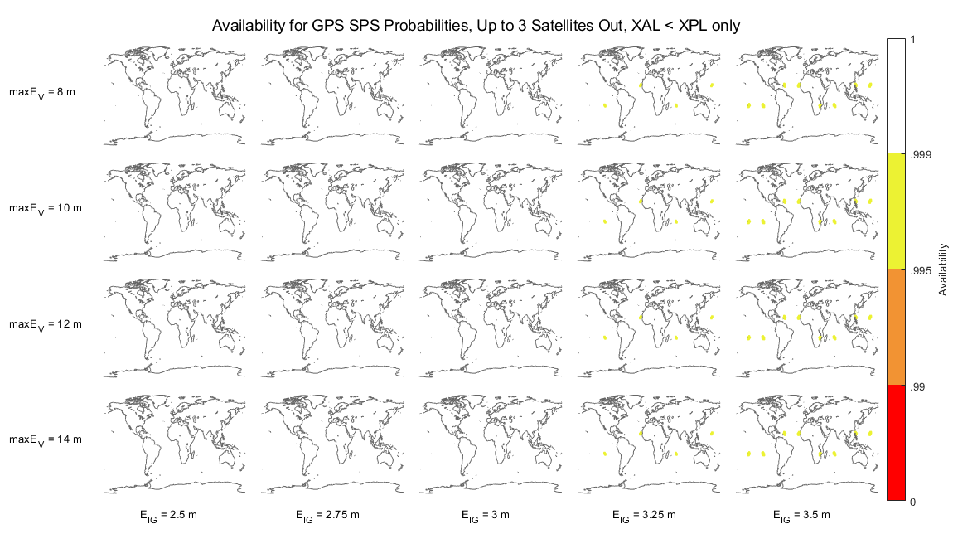
Availability Results Maps Layout
Constellation State = [24=X%, 23=X%, 22=X%, 21=X%, <21=X%]
S_{vert2} < maxE_{v} / E_{IG}
S_{vert2} < 3.2
S_{vert2} < 2.91
S_{vert2} < 2.67
S_{vert2} < 2.46
S_{vert2} < 2.23
S_{vert2} < 4
S_{vert2} < 3.63
S_{vert2} < 3.33
S_{vert2} < 2.86
S_{vert2} < 2.86
E_{V}
S_{vert2} < 4.8
S_{vert2} < 4.36
S_{vert2} < 4
S_{vert2} < 3.69
S_{vert2} < 3.43
S_{vert2} < 5.6
S_{vert2} < 5.09
S_{vert2} < 4.67
S_{vert2} < 4.31
S_{vert2} < 4
E_{IG}

Slide 9
Availability of xPL < xAL Only (no Svert Limit)
Martinez + RTCA / Minimum Constellation State = [24=95%, 23=3%, 22=1.2%, 21=0.8%, <21=0%]
Distance and VPL are not driving availability
X_{air} = 4.6 km | X_{air} = 5.1 km | X_{air} = 5.6 km | X_{air} = 6.1 km | X_{air} = 6.6 km

Slide 10
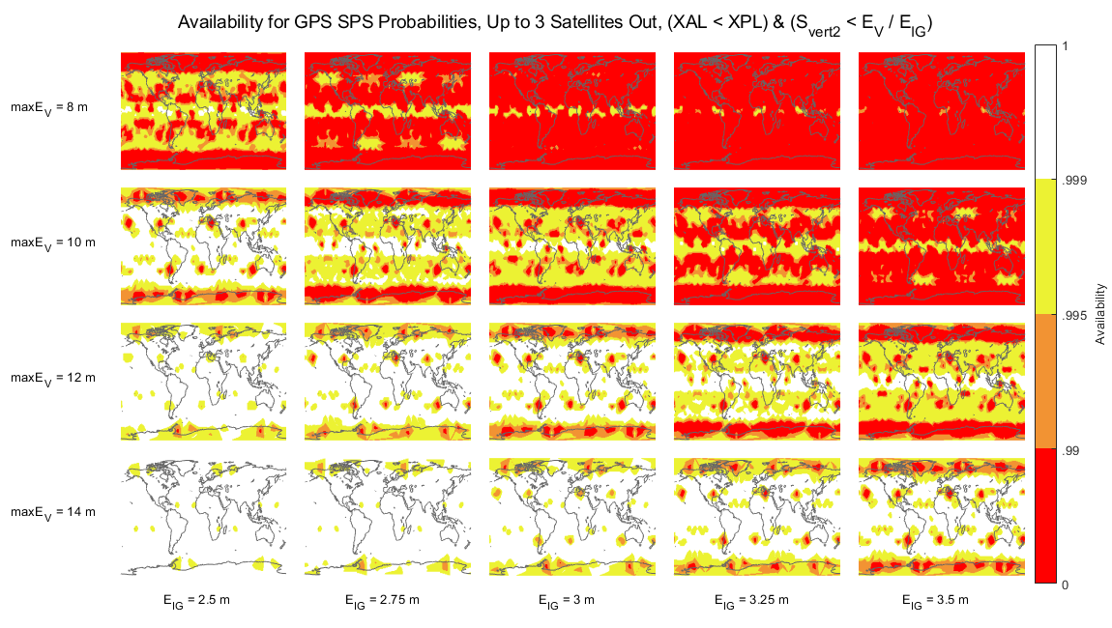
Availability of XPL < XAL & S_{vert2} < E_{V} / E_{IG}
Martinez + RTCA / Minimum Constellation State = [24=95%, 23=3%, 22=1.2%, 21=0.8%, <21=0%]
X_{air} = 4.6 km | X_{air} = 5.1 km | X_{air} = 5.6 km | X_{air} = 6.1 km | X_{air} = 6.6 km

Slide 11
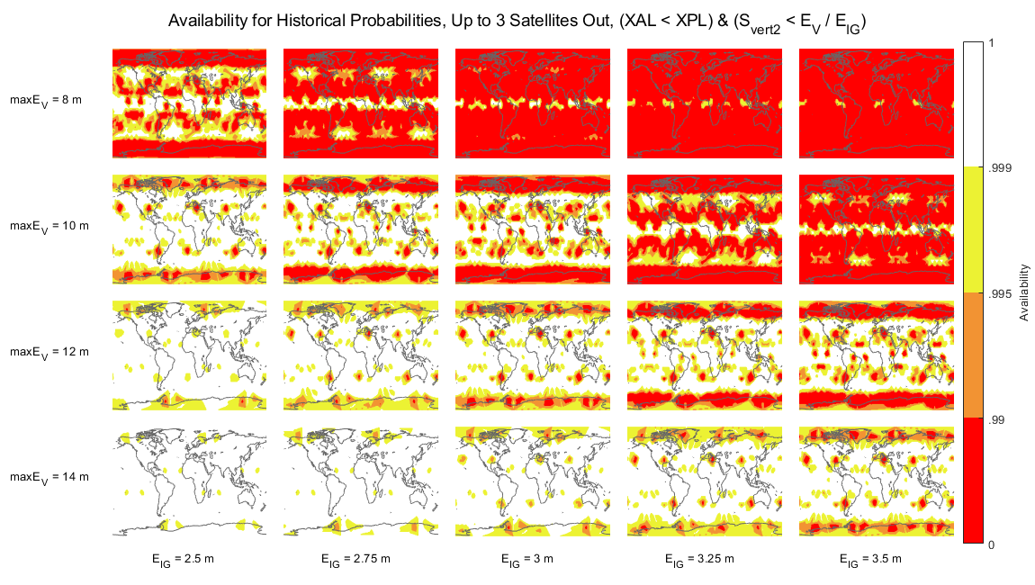
Availability of XPL < XAL & S_{vert2} < E_{V} / E_{IG}
Martinez + Historical Constellation State = [24=98.3%, 23=0.6%, 22=1.0%, 21=0.1%, <21=0%]
X_{air} = 4.6 km | X_{air} = 5.1 km | X_{air} = 5.6 km | X_{air} = 6.1 km | X_{air} = 6.6 km

Slide 12
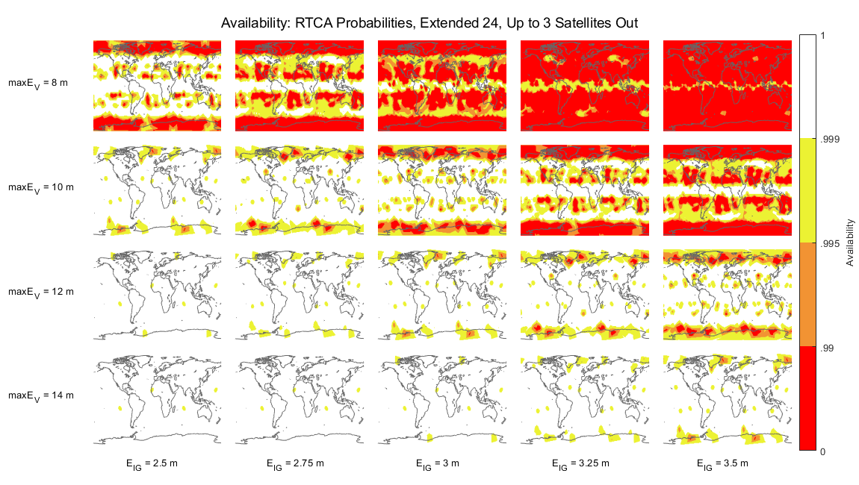
Availability of XPL < XAL & S_{vert2} < E_{V} / E_{IG}
Expanded 24 + RTCA / Minimum Constellation State = [27=95%, 26=3%, 25=1.2%, 24=0.8%, <21=0%]
X_{air} = 4.6 km | X_{air} = 5.1 km | X_{air} = 5.6 km | X_{air} = 6.1 km | X_{air} = 6.6 km

Slide 13
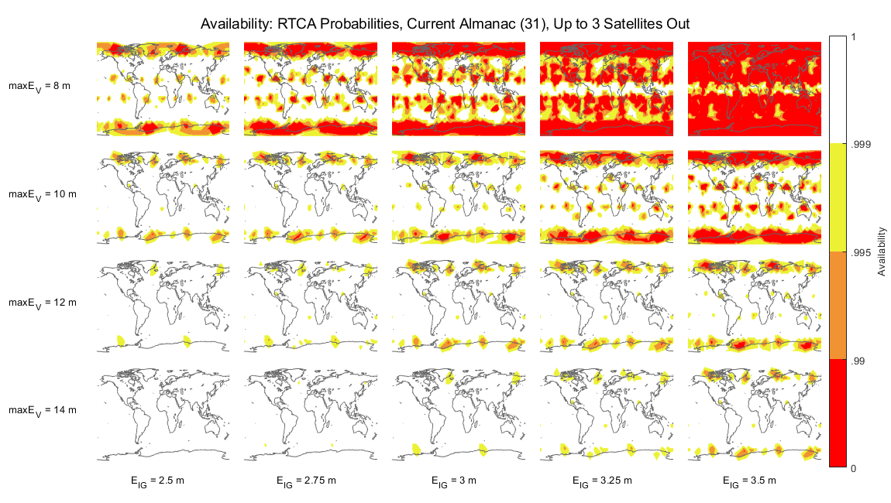
Availability of XPL < XAL & S_{vert2} < E_{V} / E_{IG}
Week 42 YUMA + RTCA / Minimum Constellation State = [31=95%, 30=3%, 29=1.2%, 28=0.8%, <28=0%]
X_{air} = 4.6 km | X_{air} = 5.1 km | X_{air} = 5.6 km | X_{air} = 6.1 km | X_{air} = 6.6 km

Slide 14
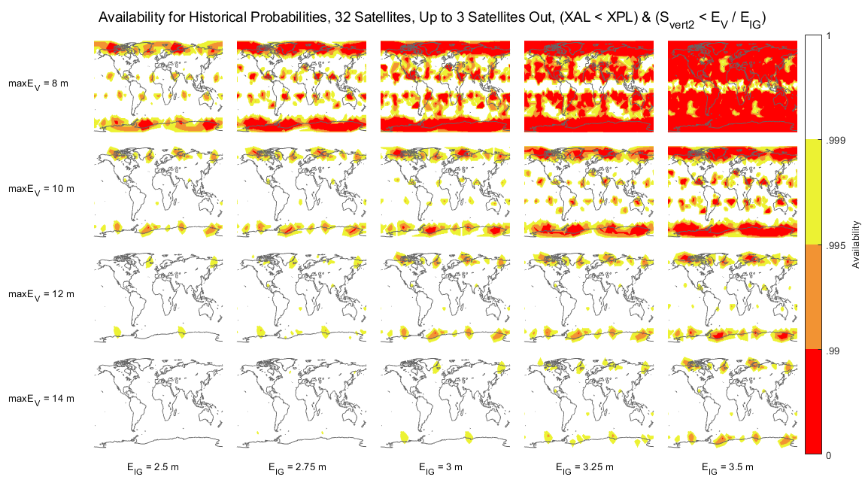
Availability of XPL < XAL & S_{vert2} < E_{V} / E_{IG}
Week 42 YUMA + Historical Constellation State = [31=98.3%, 30=0.6%, 29=1.0%, 28=0.1%, <28=0%]
31
X_{air} = 4.6 km | X_{air} = 5.1 km | X_{air} = 5.6 km | X_{air} = 6.1 km | X_{air} = 6.6 km

